Slide 1
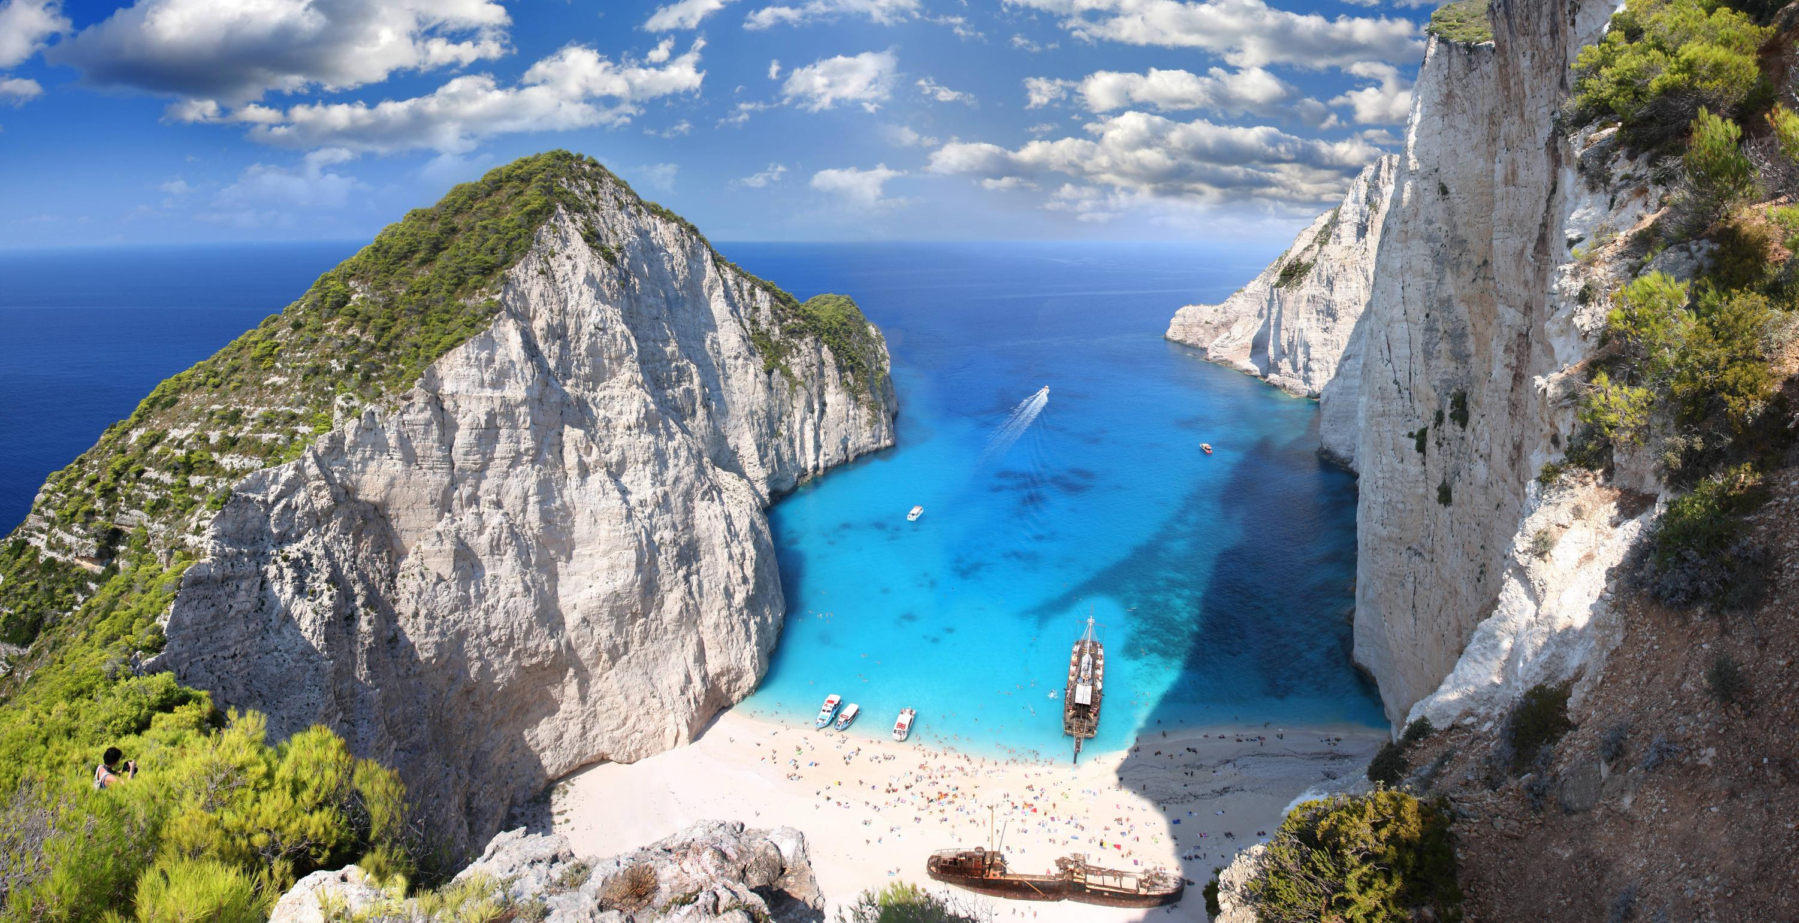
welcome
to 6998 6!

Slide 2
Computation and the Brain

Slide 3
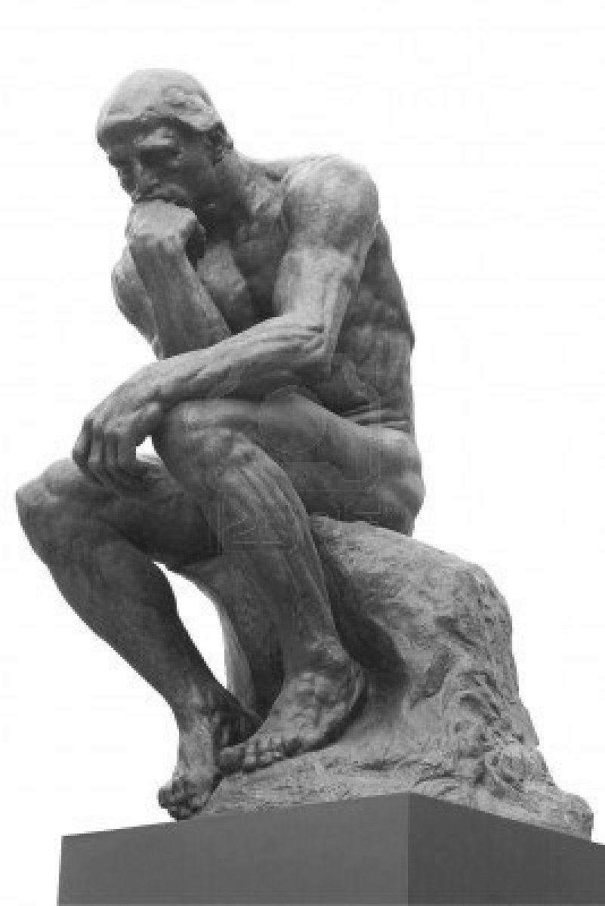
Q: Is the brain a computer?

Slide 4

A: “Face it, your brain is a computer” Gary Marcus, cognitive scientist NYU, NYT April 2015

Slide 5

A: “Your Brain is an algorithm” Yuval Harari, historian, Homo Deus 2017

Slide 7
COMPUTER | THE BRAIN
Inorganic | Alive
Exact | Error prone
70 – 7,000,000 Watts | 20 Watts
Chess, Go, Jeopardy | Survival, creativity, dreams
10¹⁰ ⁻⁻ ¹⁸ operations/s 1 – 40,000 processors | 50 operations/s, 10¹¹ components
Connects to others | If in the mood
Was designed | Has evolved
Cool machine | Rather emotional
Behavior is deliberately programmed | Behavior is emergent

Slide 8
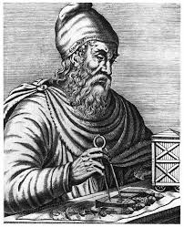

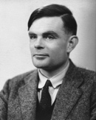
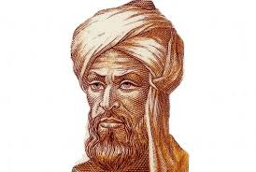
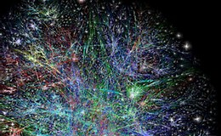
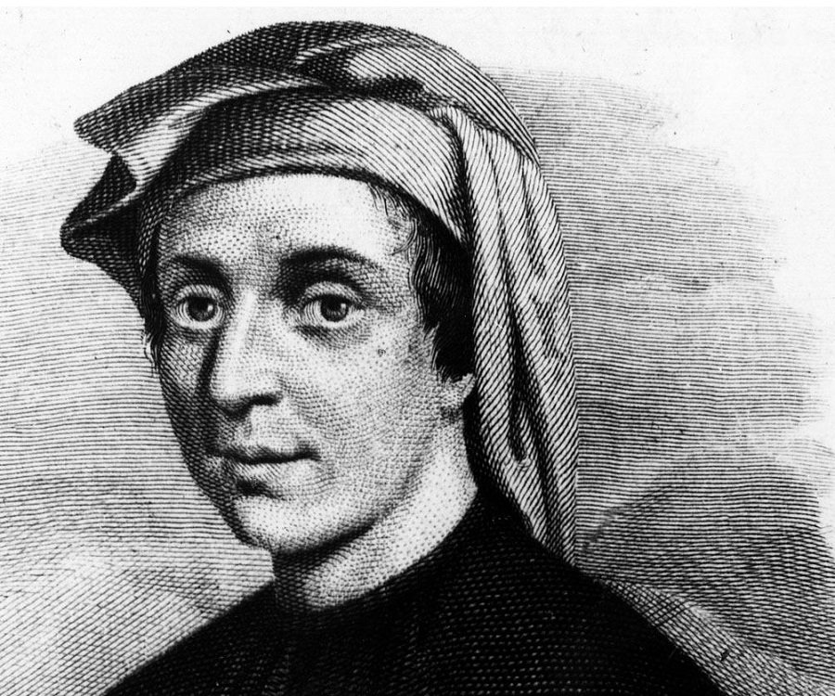
Let’s look at history. Computation timeline first

Slide 9
Neuroscience
Alcmaeon of Croton 520 BC
Hippocrates 400 BC vs Aristotle 330 BC vs Galen 100AD
…
L. Galvani electrical activity 1760
Broca and Wernicke: language in the brain 1870
C. Golgi reazione nera (Golgi stain) 1872
S. Ramon y Cajal neuron drawings, axonal cone 1880
Reticulism vs the neuron hypothesis and the Nobel fight, 1906

Slide 10
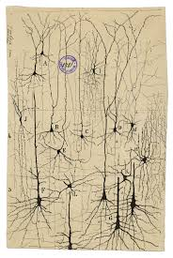
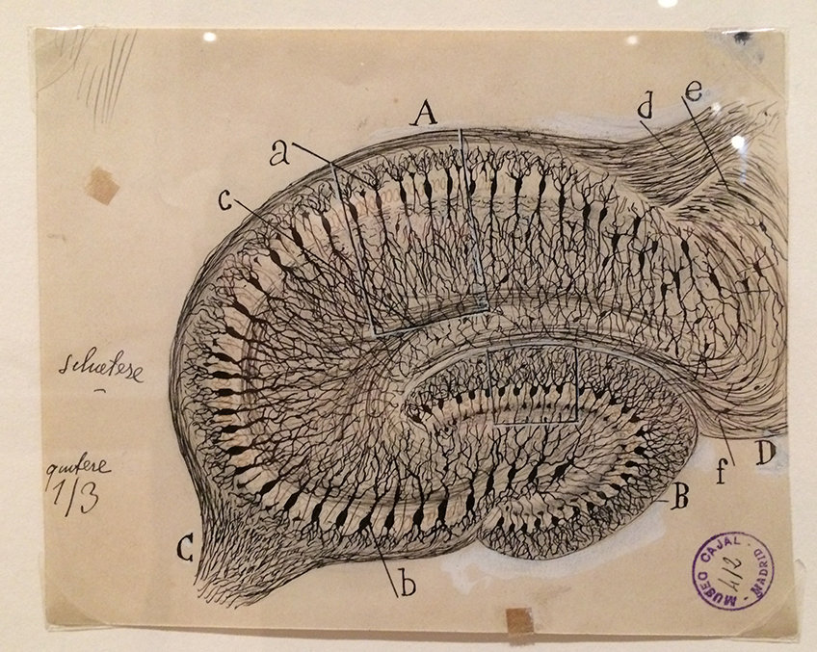

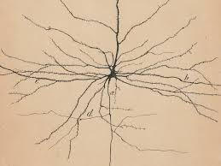
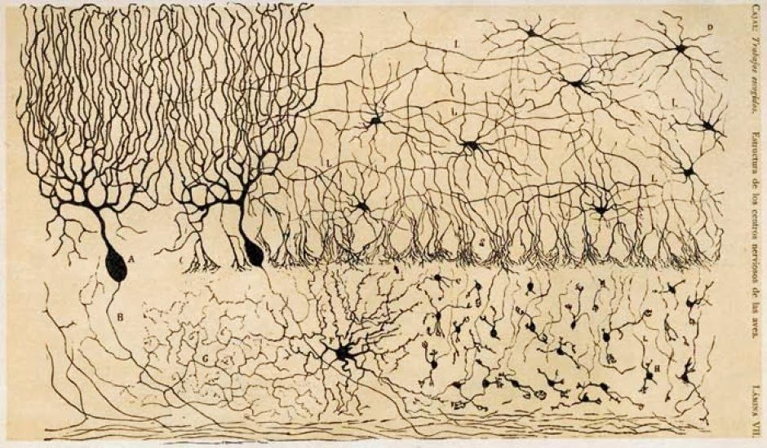
The beautiful brain

Slide 11
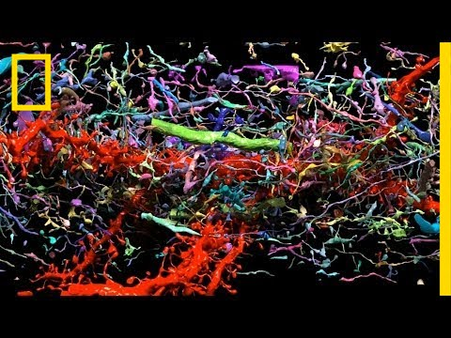
Connectomexplorer

Slide 12
Next: The rise of Neuroscience, as seen from Karolinska

Slide 13
1906: Ramon y Cajal and Golgi: the neuron
1932: C. Sherrington: the synapse
1936: H. Dale and O. Loewi: neurotransmitters
1963: Eccles, Hodgkin, Huxley: the spike
1967 Granit, Hartline, and Wald; 1981 Sperry, Hubel, and Wiesel: vision
1970: Katz, von Euler, Axelrod: synaptic vesicles
1991: Neher – Sakmann; 2000: Carlsson, Greengard, Kandel: ion channels
2006: R. Axel and L. Buck: olfaction
2014: O’Keefe, M. Moser, and E. Moser: place cells and grid cells

Slide 14
Next: brief discussions of the lauded topics
The neuron
Synapses
Neurotransmitters and vesicles
Spikes and Ion channels
Olfaction
Place cells and grid cells
Vision
Plus: the rise of the computer-brain interface, 1944 – 1990

Slide 15
But first: About the class
TAs: Jacob Portes, Tim Randolph, Kiran Vodrahali (and Dan Mitropolski?)
Weekly reading assignments, plus talks to watch, posted Wednesday night.
Research papers researched
Weekly responses to the readings/talks, due Wednesday at noon. Plus 1-2 discussion points
Resources
Attendance and participation
Final project: ideally in groups of 3-4

Slide 16
Also: Deep Learning to Learn Pieter Abbeel University of California, Berkeley Monday, Sep. 10, 11:30, Davis Auditorium

Slide 17
Next: brief discussions of the lauded topics
The neuron
Synapses
Neurotransmitters and vesicles
Spikes and Ion channels
Olfaction
Place cells and grid cells
Vision
Plus: the rise of the computer-brain interface, 1944 – 1990

Slide 18
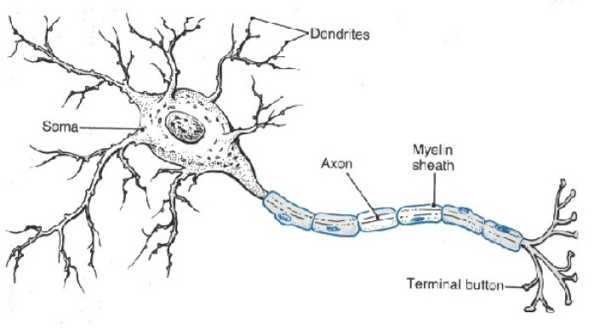
The Neuron
soma
dendrite
axon
cone
myeline
boutons and spines
membrane and its potential (-70 mV in steady state)

Slide 19
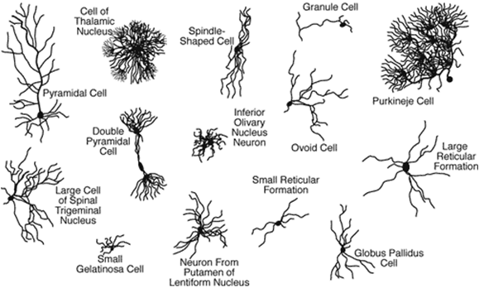
The Neuron
soma
dendrite
axon
myeline
boutons and spines
many kinds

Slide 20
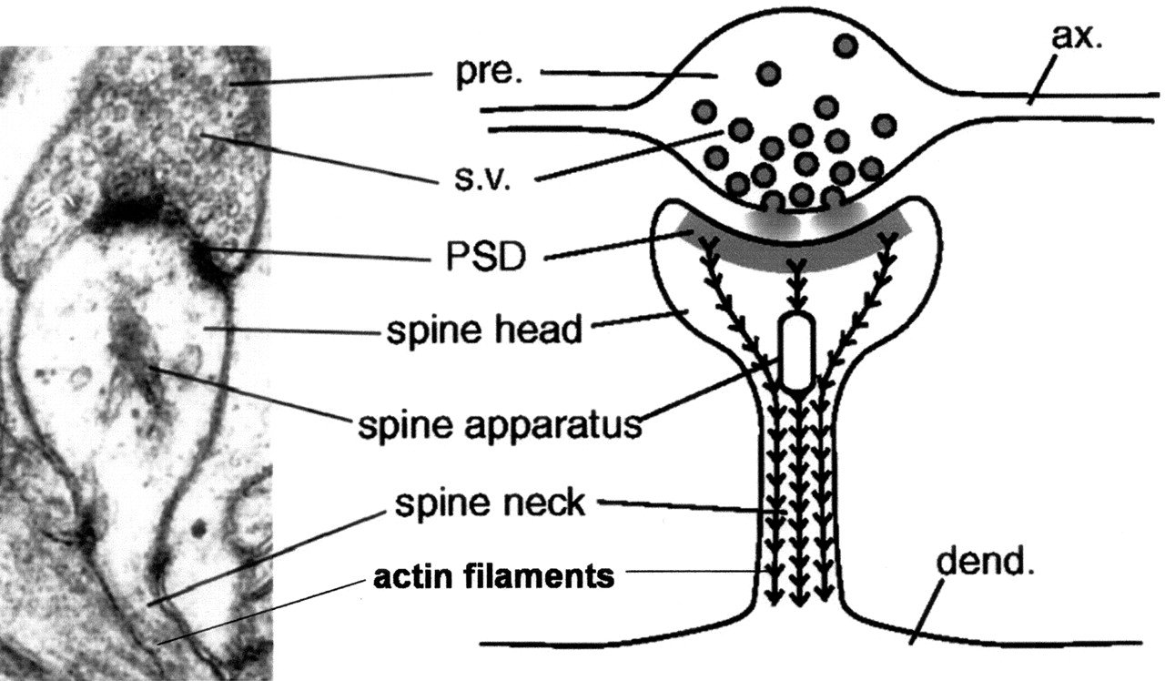
The synapse
Bouton
Spine
Cleft

Slide 21
Connectomexplorer

Slide 22
The synapse
Bouton
Spine
Cleft
Synaptic weight and its plasticity

Slide 23
Neurotransmitters
The chemical language of neurons
The main result of the firing of a neuron is the release of neurotransmitter molecules at the synaptic clefts, and their uptake by the post-synaptic neurons
Some neurotransmitters (Glu, GABA) affect membrane potential and eventually the firing of postsynaptic neurons
Others (dopamine, seratonin, oxytocin) act in more complex ways…

Slide 24
Neurotransmitters: many kinds
Amino acids: glutamate, aspartate, D-serine, γ-aminobutyric acid (GABA), glycine
Gasotransmitters: nitric oxide (NO), carbon monoxide (CO), hydrogen sulfide (H₂S)
Monoamines: dopamine (DA), norepinephrine (noradrenaline; NE, NA), epinephrine (adrenaline), histamine, serotonin (SER, 5-HT)
Trace amines: phenethylamine, N-methylphenethylamine, tyramine, 3-iodothyronamine, octopamine, tryptamine, etc.
Peptides: somatostatin, substance P, cocaine and amphetamine regulated transcript, opioid peptides^{[11]}
Purines: adenosine triphosphate (ATP), adenosine
Others: acetylcholine (ACh), anandamide, etc.

Slide 25
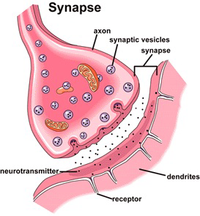
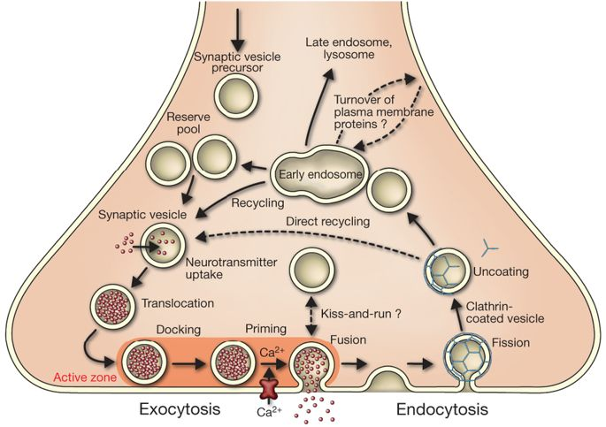
Vesicles release neurotransmitters

Slide 26
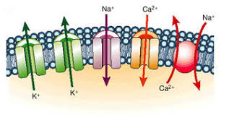
Ion channels
Voltage gated, or
Ligand gated (controlled by other neurotransmitters…)
Glu lets X⁺ in: excitatory
GABA lets X⁻ in: inhibitory
Ions define the membrane potential of the neuron

Slide 27
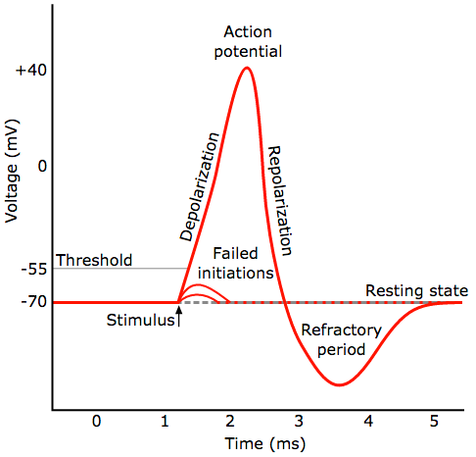
The spike

Slide 28
The spike, how?
Resting potential = K⁺ balance
Accumulation of excitatory input raises potential
When threshold passed, voltage-gated influx of Na⁺ : depolarization
1ms later, a voltage-gated massive outflux of K⁺: back to resting potential and beyond: hyperpolarization
Refractory period ~1ms

Slide 29
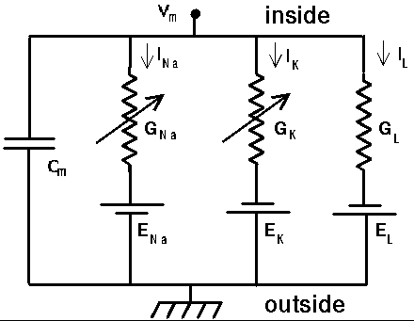
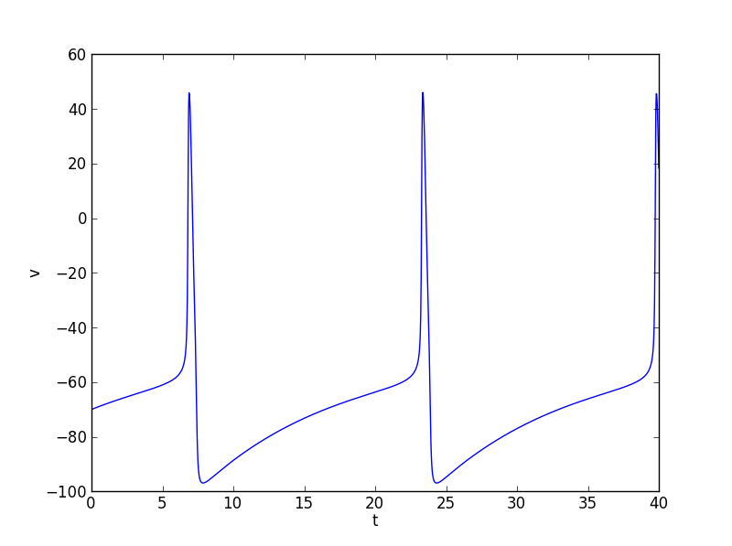
The spike, how?
The Hodgkin-Huxley differential equations (EE version)

Slide 30
Meanwhile at the (CS) farm…
1944: McCulloch – Pitts neuron

Slide 31
McCulloch-Pitts paper

Slide 32
Meanwhile at the (CS) farm…
1944: McCulloch – Pitts neuron
1957: The Rosenblatt perceptron
"the embryo of an electronic computer that the Navy expects will be able to walk, talk, see, write, reproduce itself and be conscious of its existence.” NYT 1957
1960s: XOR and the first AI winter; the Minsky – Papert perceptron and the genesis of deep nets
Also 1960s: “Neuroscience”, “neurone”

Slide 33
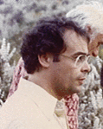
David Marr (1945 – 1980) and the genesis of computational neuroscience The Three Step Program: -specs -hardware -algorithm

Slide 34
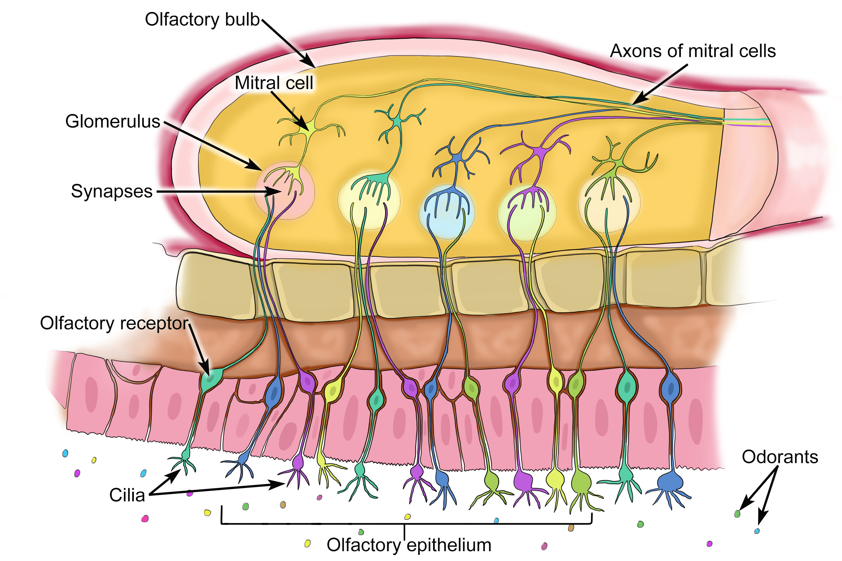
Back to the Neuroscience laureates: Olfaction

Slide 35
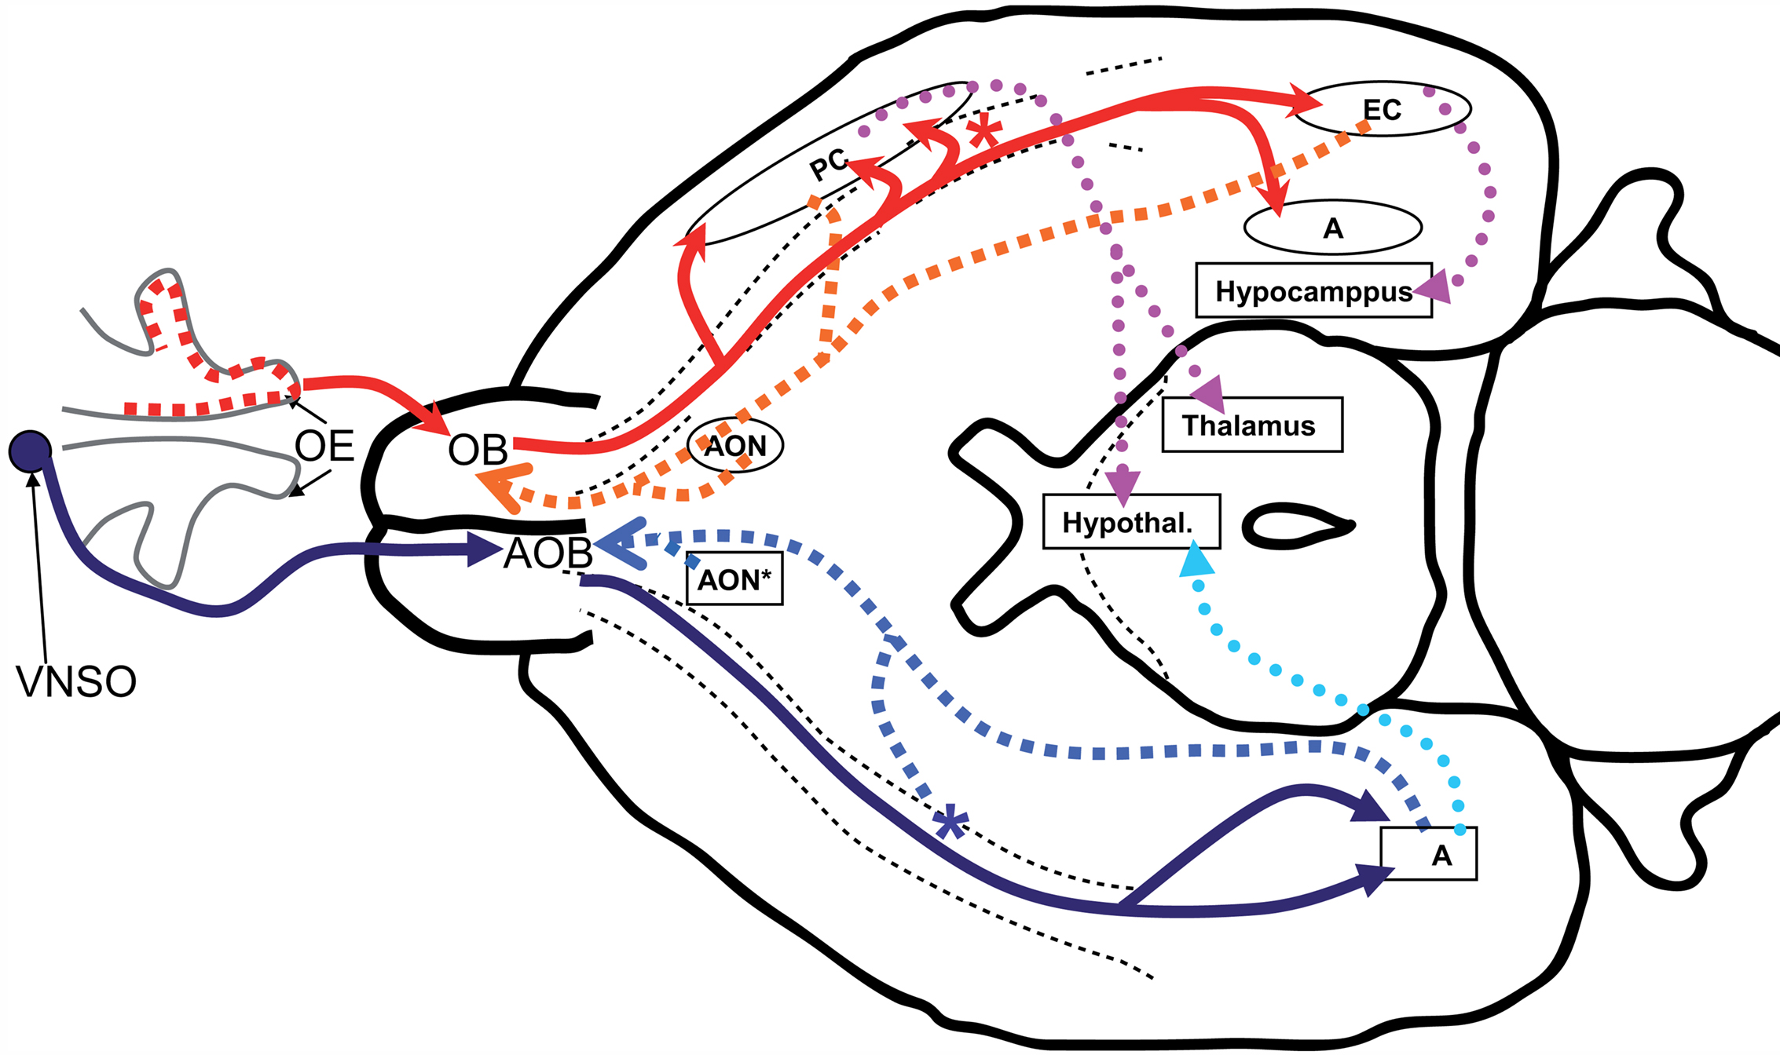
Olfaction

Slide 36
OK, what are the parts of the brain?

Slide 37
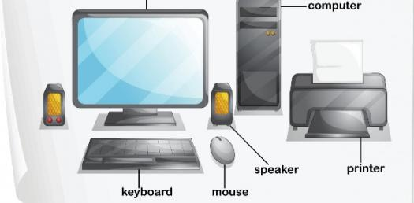
Oops, first, what are the parts of the computer?

Slide 38
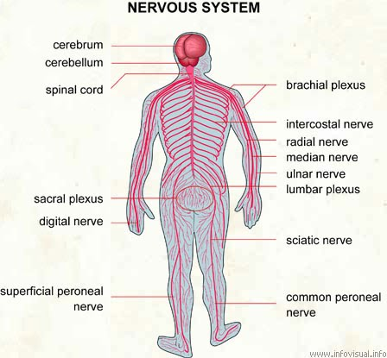
OK, back to the parts of the brain

Slide 39
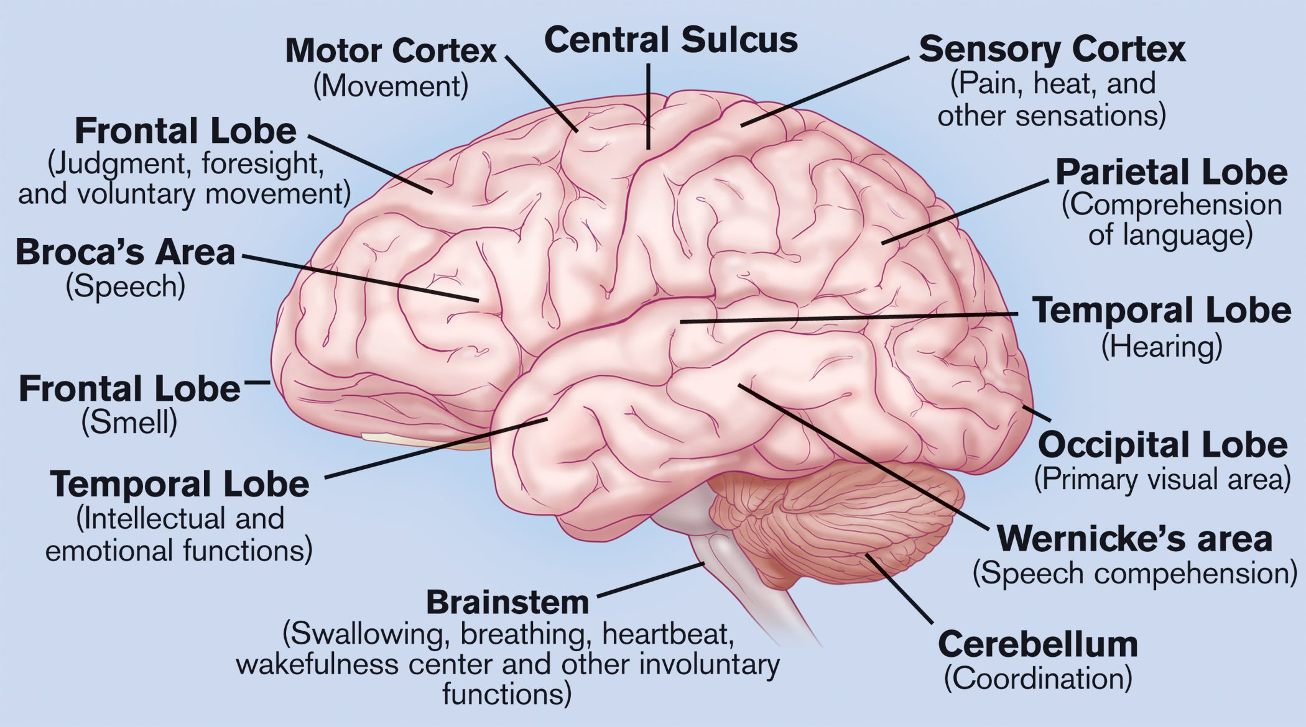
OK, the parts of the brain

Slide 40
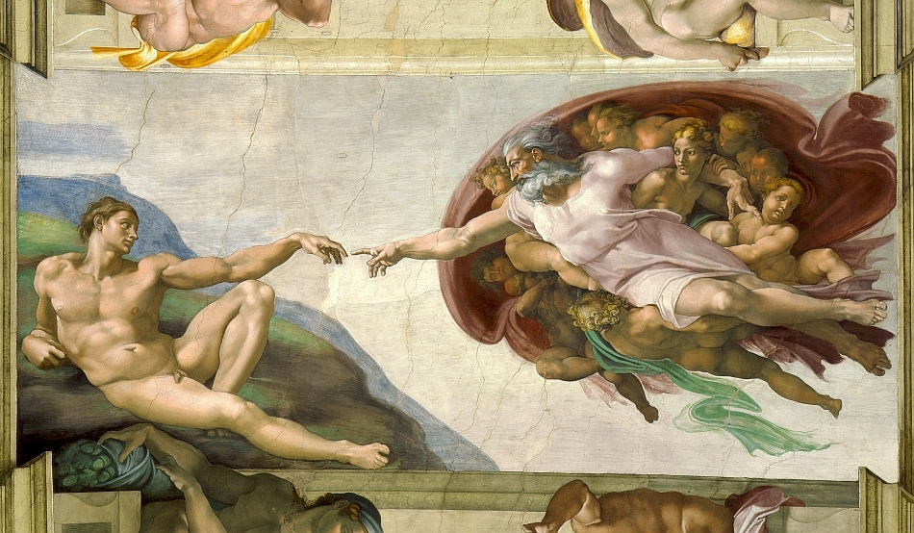
Btw, parts of the brain?

Slide 41
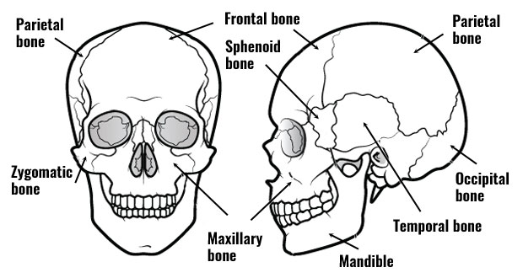
Parts of the brain names: Bones of the skull

Slide 42
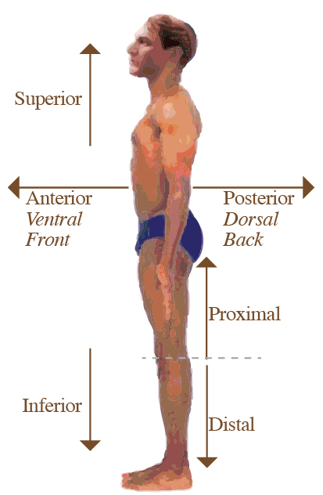
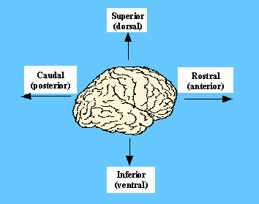
Parts of the brain names: directions

Slide 43
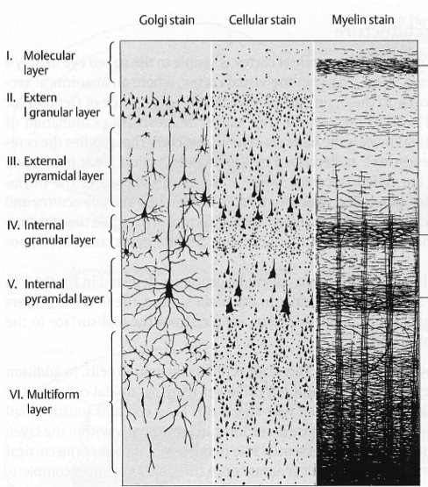
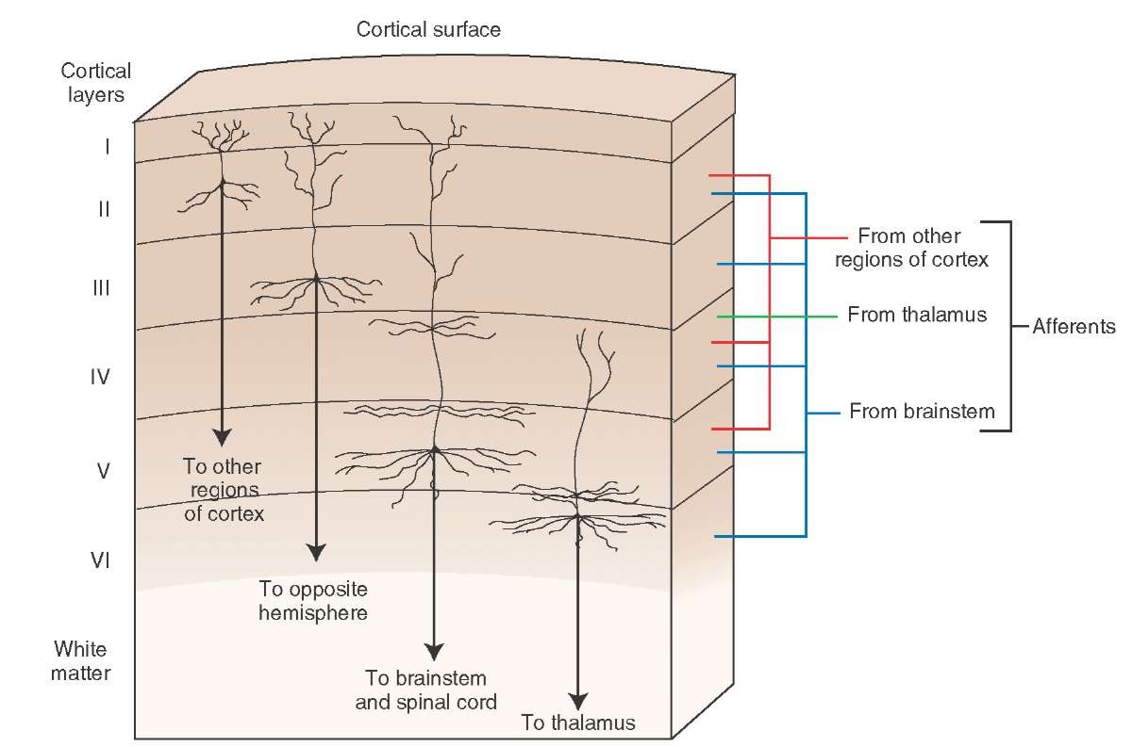
(Cerebral) Cortex: the engine
1.5 mm
2500 cm²
six layers
20B neurons

Slide 44
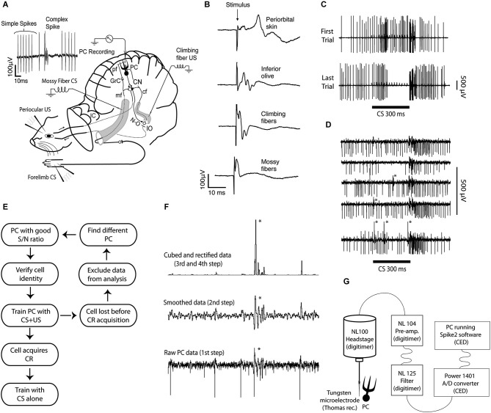
Finally: how do we record from the brain? Single unit: ~ 1 neuron, ~ 1ms

Slide 45
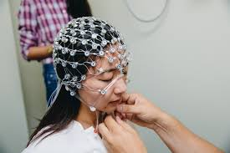
how do we record from the brain? EEG: 1cm, 1ms

Slide 46
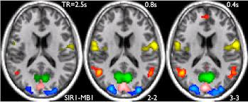
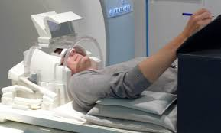
how do we record from the brain? fMRI: ~ 1mm, ~ 1s (+ ML!)

Slide 47
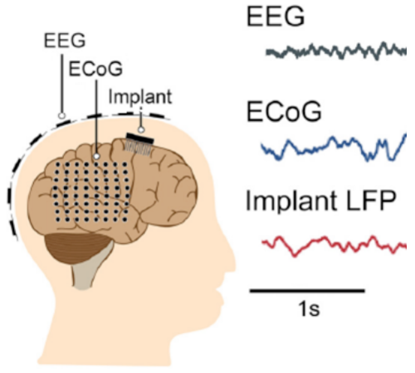
how do we record from the brain? ECoG

Slide 48
Place cells
Neurons in the hippocampus that fire when the animal is in a particular place
https://www.youtube.com/watch?v=STyd1qJr3yM

Slide 49
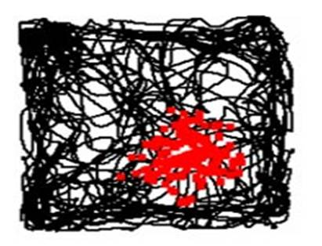
Place cells
Tuning curve of a place cell:
A neuron in the hippocampus that fires when the animal is in a particular place
https://www.youtube.com/watch?v=STyd1qJr3yM

Slide 50
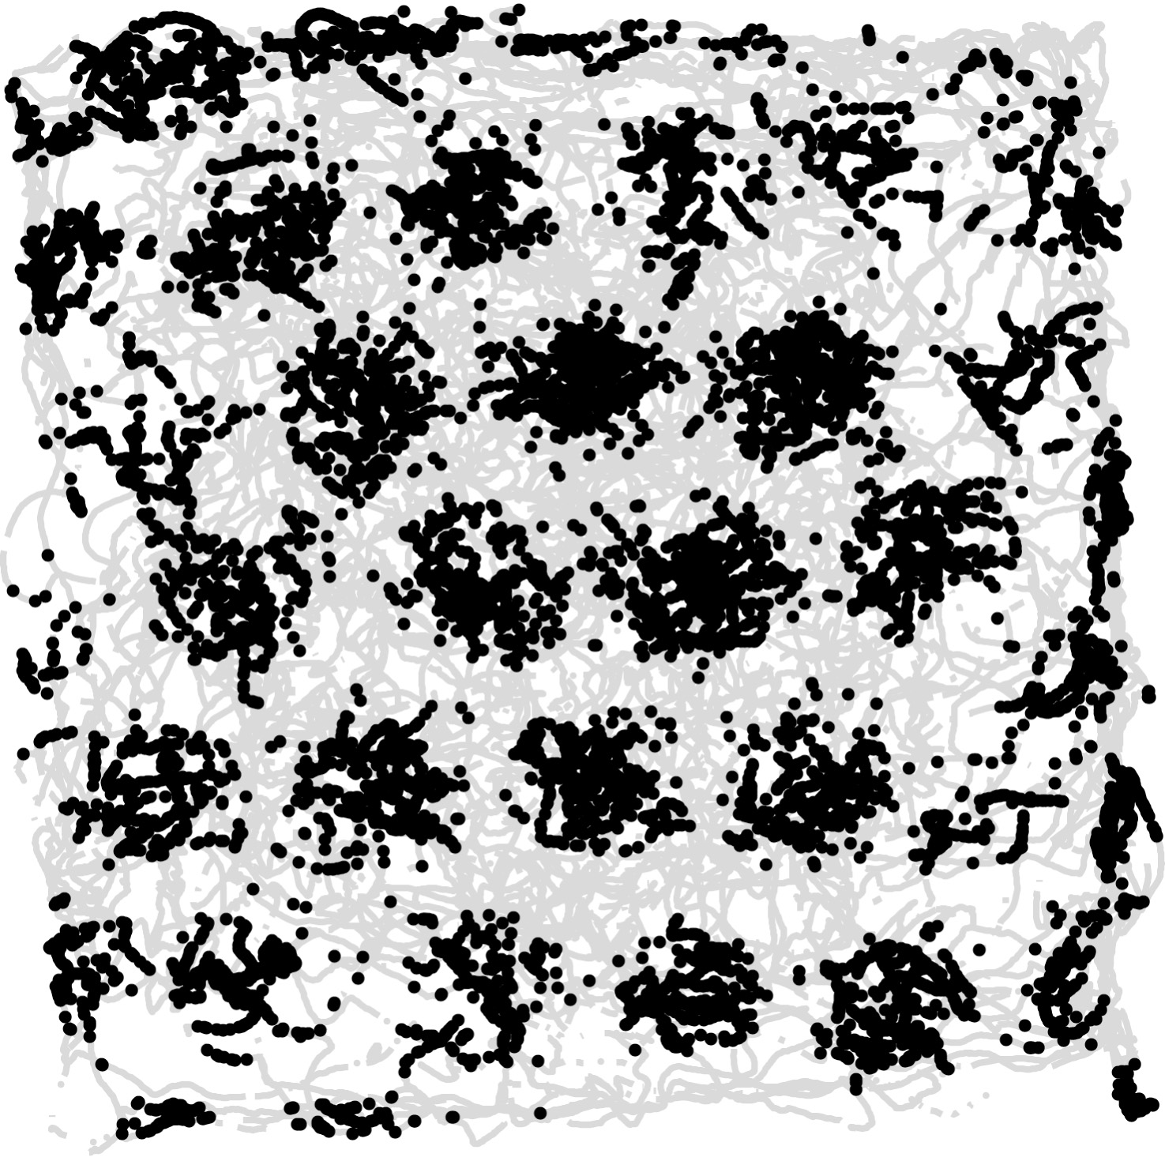
Grid cells
Tuning curve of a grid cell
A neuron in the entorhinal cortex that fires when the animal is in any one of the nodes of a triangular grid
The movie:
https://www.youtube.com/watch?v=i9GiLBXWAHIons in

Slide 51
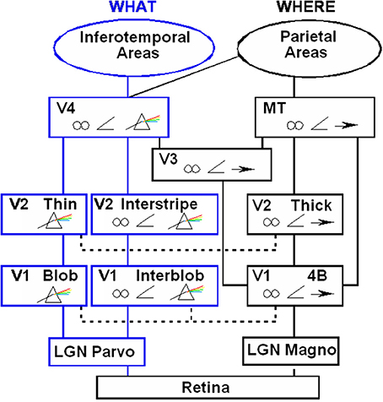
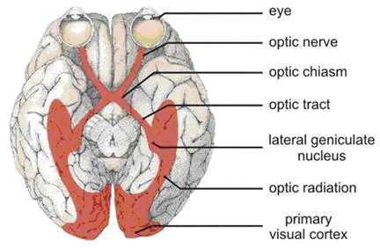
Vision

